Slide 1
Content
Last presentation review
Theoretical basis
Testing the dual-ascent algorithm: random walk problem (modified)
Roadmap: where are we going?
Dual-ascent with linear function approximation
Algorithm foundations
Random walk
Mountain car
Future lines (04/05/2017)
DANIEL GARCÍA-OCAÑA HERNÁNDEZ

Slide 2
Content
LAST PRESENTATION REVIEW
THEORETICAL BASIS
Testing the dual-ascent algorithm: random walk problem (modified)
Roadmap: where are we going?
Dual-ascent with linear function approximation
Algorithm foundations
Random walk
Mountain car
Future lines (04/05/2017)

Slide 3

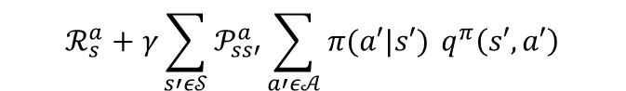
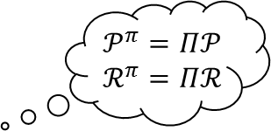
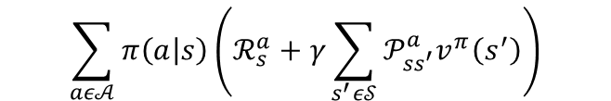
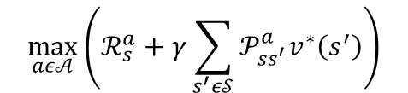


Bellman’s equations
$$𝒫^{π}=Π𝒫$$
$$ℛ^{π}=Πℛ$$
a
$v^{π}\left(s\right)=𝔼_{π,𝒫}\left[G_{t} | S_{t}=s, A_{t}\sim π\right]=𝔼_{π,𝒫}\left[R_{t+1}+γv^{π}(S_{t+1}) | S_{t}=s, A_{t+k}\sim π\right]=$
$$\sum_{aε𝒜}{π\left(a | s\right)\left(ℛ_{s}^{a}+γ\sum_{s^{′}ε𝒮}{𝒫_{ss^{′}}^{a}v^{π}\left(s^{′}\right)}\right)}$$
vector form
$$v^{π}=ℛ^{π}+γ𝒫^{π}v^{π}$$
$v^{∗}\left(s\right)=\max_{aε𝒜}{𝔼_{𝒫}\left[R_{t+1}+γv^{∗}(S_{t+1}) | S_{t}=s\right]}=$
$$\max_{aε𝒜}\left(ℛ_{s}^{a}+γ\sum_{s^{′}ε𝒮}{𝒫_{ss^{′}}^{a}v^{∗}\left(s^{′}\right)}\right)$$
$q^{π}\left(s,a\right)=𝔼_{π,𝒫}\left[G_{t} | S_{t}=s,A_{t}=a,A_{t+k}\sim π\right]=𝔼_{π,𝒫}\left[R_{t+1}+γq^{π}\left(S_{t+1},A_{t+1}\right) | S_{t}=s,A_{t}=a,A_{t+k}\sim π\right]=$
$$ℛ_{s}^{a}+γ\sum_{s′ε𝒮}{𝒫_{ss′}^{a}\sum_{a′ε𝒜}{π(a′|s′) }q^{π}\left(s′,a′\right)}$$
vector form
$$q^{π}=ℛ+γ𝒫Πq^{π}$$
$q^{∗}\left(s,a\right)=\max_{aε𝒜}{𝔼_{𝒫}\left[R_{t+1}+γq^{∗}(S_{t+1},A_{t+1}) | S_{t}=s,A_{t}=a\right]}=$
$$ℛ_{s}^{a}+γ\sum_{s′ε𝒮}{𝒫_{ss′}^{a}\max_{a′ε𝒜}{ q}^{∗}\left(s′,a′\right)}$$
Notes:
3.23, 24, 28 y 29
transition probability matrix and the expected reward vector for policy all possible deterministic policies (3.42 y 3.43)
La óptima sigue una greedy policy (3.56)

Slide 4


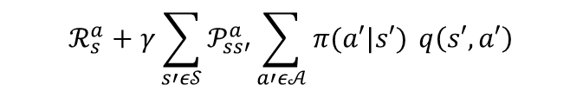
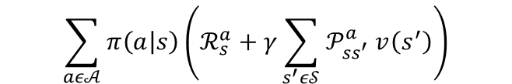

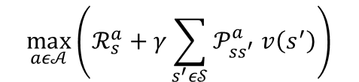


Bellman’s operator: definition
a
$\left(T_{π}v\right)\left(s\right)≜𝔼_{π,𝒫}\left[R_{t+1}+γv(S_{t+1}) | S_{t}=s, A_{t+k}\sim π\right]=$
$$\sum_{aε𝒜}{π\left(a | s\right)\left(ℛ_{s}^{a}+γ\sum_{s^{′}ε𝒮}{𝒫_{ss^{′}}^{a} v\left(s^{′}\right)}\right)}$$
vector form
$$T_{π}v$$
$(Tv)\left(s\right)≜\max_{aε𝒜}{𝔼_{𝒫}\left[R_{t+1}+γv(S_{t+1}) | S_{t}=s\right]}=$
$$\max_{aε𝒜}\left(ℛ_{s}^{a}+γ\sum_{s^{′}ε𝒮}{𝒫_{ss^{′}}^{a} v\left(s^{′}\right)}\right)$$
vector form
$$Tv$$
$\left(T_{π}q\right)\left(s,a\right)≜𝔼_{π,𝒫}\left[R_{t+1}+γq\left(S_{t+1},A_{t+1}\right) | S_{t}=s,A_{t}=a,A_{t+k}\sim π\right]=$
$$ℛ_{s}^{a}+γ\sum_{s′ε𝒮}{𝒫_{ss′}^{a}\sum_{a′ε𝒜}{π(a′|s′) }q\left(s′,a′\right)}$$
vector form
$$T_{π}q$$
$(Tq)\left(s,a\right)≜\max_{aε𝒜}{𝔼_{𝒫}\left[R_{t+1}+γq(S_{t+1},A_{t+1}) | S_{t}=s,A_{t}=a\right]}=$
$$ℛ_{s}^{a}+γ\sum_{s′ε𝒮}{𝒫_{ss′}^{a}\max_{a′ε𝒜} q\left(s′,a′\right)}$$
vector form
$$Tq$$
Notes:
Lío con la notación!!
A shorthand notation → notación taquigráfica
Mapping que transforma la función de v a S en una función de Tv a S (FUNCIONAL)
Aplicando el operador de bellman N veces convergemos a v óptima (dynamic programm)

Slide 5
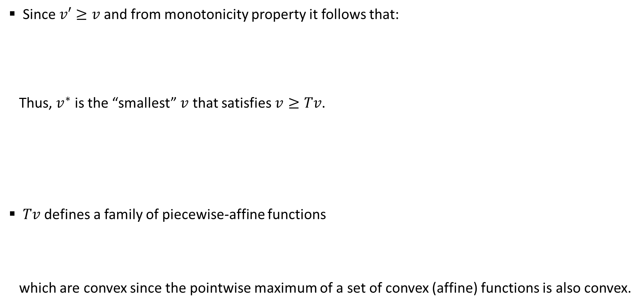
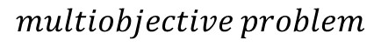
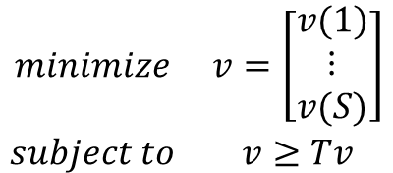
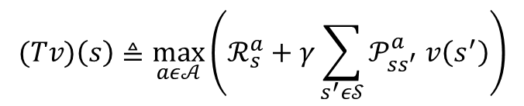
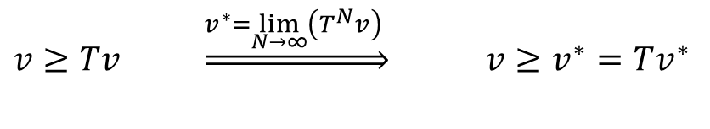
DP formulation as an LP (I)
Since$v′≥v$ and from monotonicity property it follows that:
Thus, $v^{∗}$ is the “smallest” $v$ that satisfies $v≥Tv$.
$Tv$ defines a family of piecewise-affine functions
which are convex since the pointwise maximum of a set of convex (affine) functions is also convex.
Optimal cost function condition
$v≥Tv \underset{⇒}{v^{∗}=\lim_{N→∞}\left(T^{N}v\right) }$ ${v≥v}^{∗}=Tv^{∗}$
$$\begin{matrix}minimize & v=\left[\begin{matrix}v(1) \\ \begin{matrix}⋮ \\ v(S)\end{matrix}\end{matrix}\right] \\ subject to & v≥Tv\end{matrix}$$
$$multiobjective problem$$
$$(Tv)\left(s\right)≜\max_{aε𝒜}\left(ℛ_{s}^{a}+γ\sum_{s^{′}ε𝒮}{𝒫_{ss^{′}}^{a} v\left(s^{′}\right)}\right)$$
Notes:
Multiobjective = vector optimization problem

Slide 6
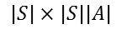
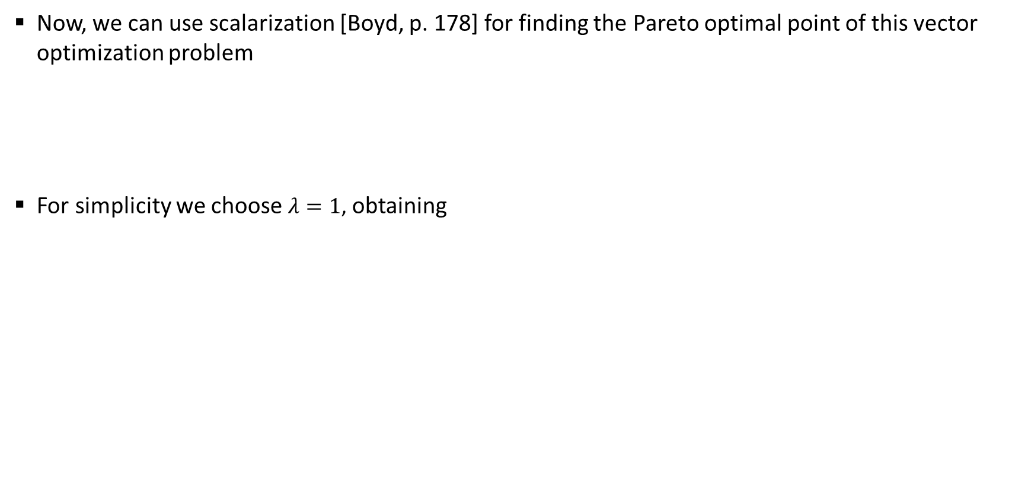
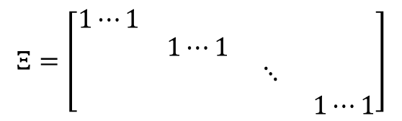

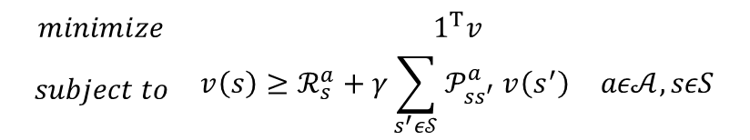
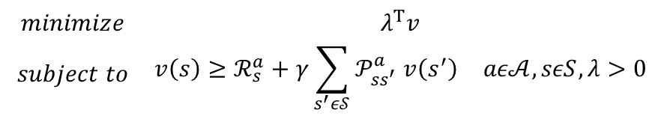
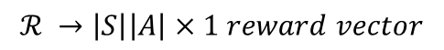
DP formulation as an LP (II)
Now, we can use scalarization [Boyd, p. 178] for finding the Pareto optimal point of this vector optimization problem
For simplicity we choose $λ=1$, obtaining
$$\begin{matrix}minimize & λ^{T}v \\ subject to & \begin{matrix}{v\left(s\right)≥ℛ}_{s}^{a}+γ\sum_{s^{′}ε𝒮}{𝒫_{ss^{′}}^{a} v\left(s^{′}\right)} & aε𝒜,sεS,λ>0\end{matrix}\end{matrix}$$
DP formulation as an LP
$$\begin{matrix}minimize & 1^{T}v \\ subject to & \begin{matrix}{v\left(s\right)≥ℛ}_{s}^{a}+γ\sum_{s^{′}ε𝒮}{𝒫_{ss^{′}}^{a} v\left(s^{′}\right)} & aε𝒜,sεS\end{matrix}\end{matrix}$$
vector form
$$\begin{matrix}minimize & 1^{T}v \\ subject to & Ξ^{T}v≥{ℛ+γ𝒫v} \end{matrix}$$
$$ℛ →\left|S\right|\left|A\right|×1 reward vector$$
$$Ξ=\left[\begin{matrix}1⋯1 & \begin{matrix}1⋯1 & 11 & 1⋯1\end{matrix} \\ \begin{matrix}1⋯1 \\ \begin{matrix}1⋯1 \\ 1⋯1\end{matrix}\end{matrix} & \begin{matrix}\begin{matrix}1⋯1 \\ \begin{matrix}1⋯1 \\ 1⋯1\end{matrix}\end{matrix} & \begin{matrix}\begin{matrix}11 & 1⋯1\end{matrix} \\ \begin{matrix}\begin{matrix}⋱ & 1⋯1\end{matrix} \\ \begin{matrix}11 & 1⋯1\end{matrix}\end{matrix}\end{matrix}\end{matrix}\end{matrix}\right]$$
$$𝒫 →\left|S\right|\left|A\right|×\left|S\right| transition matrix$$
$$|S|×|S||A|$$
$$v →\left|S\right|×1 state value function vector$$
Notes:
Multiobjective = vector optimization problem

Slide 7
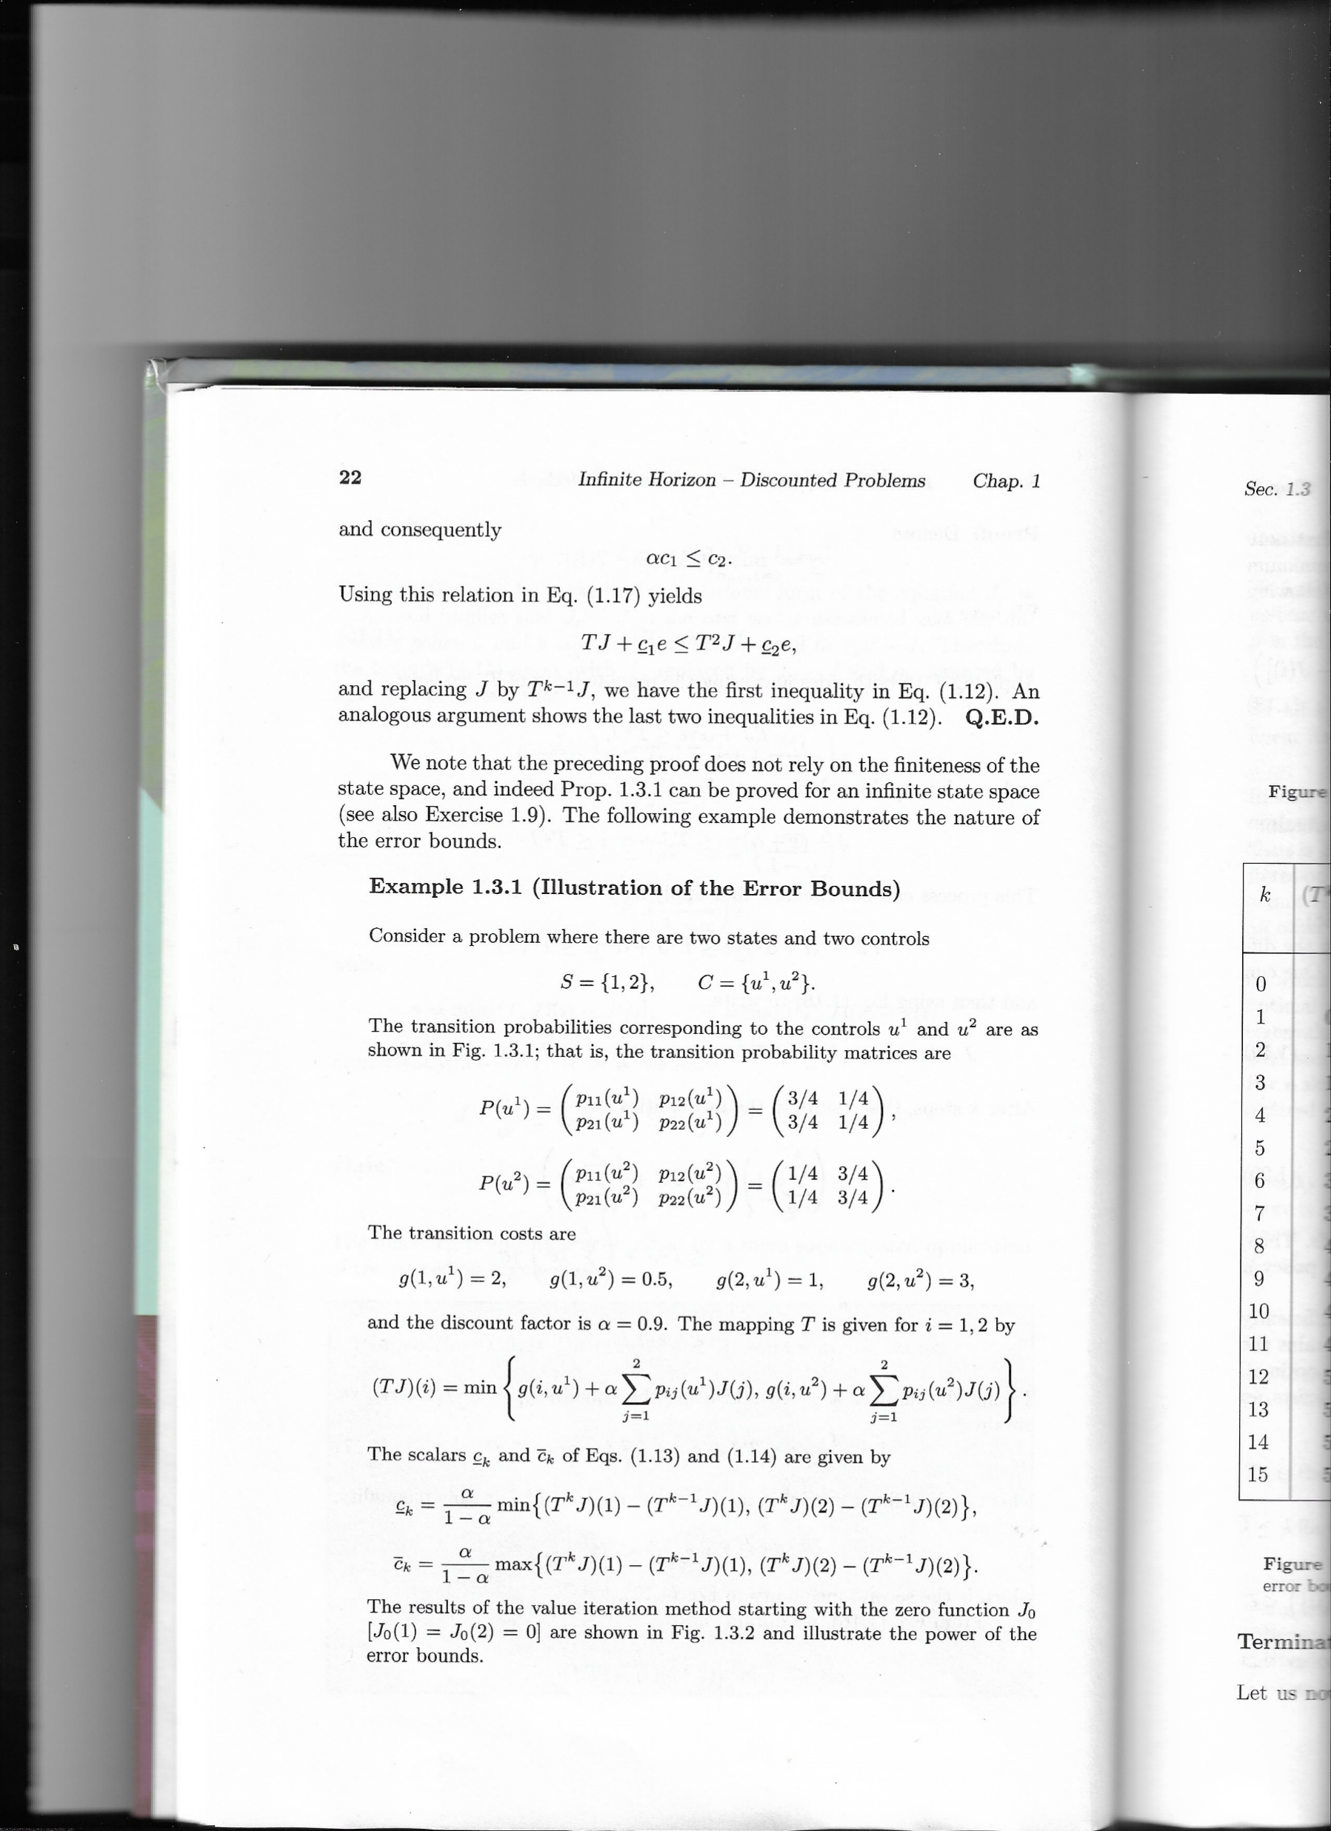

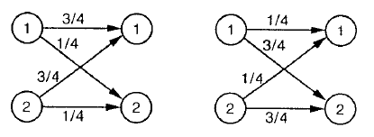
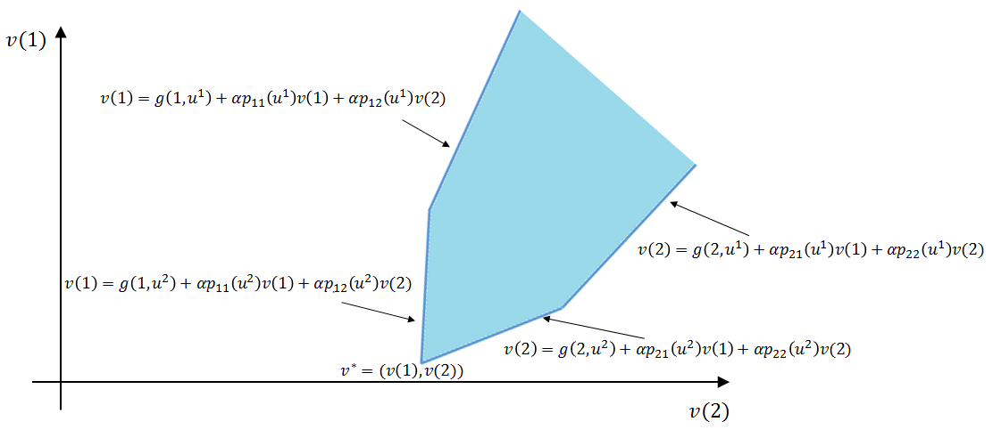
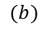
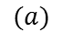
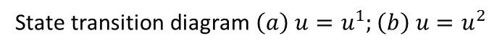
DP formulation as an LP (IV)
In order to summar
$$(a)$$
$$(b)$$
State transition diagram $\left(a\right) u=u^{1};\left(b\right) u=u^{2}$
Notes:
El state transition diagram muestra las transition probabilities corresponding to the controls u1 and u2

Slide 8
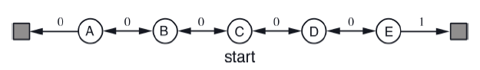
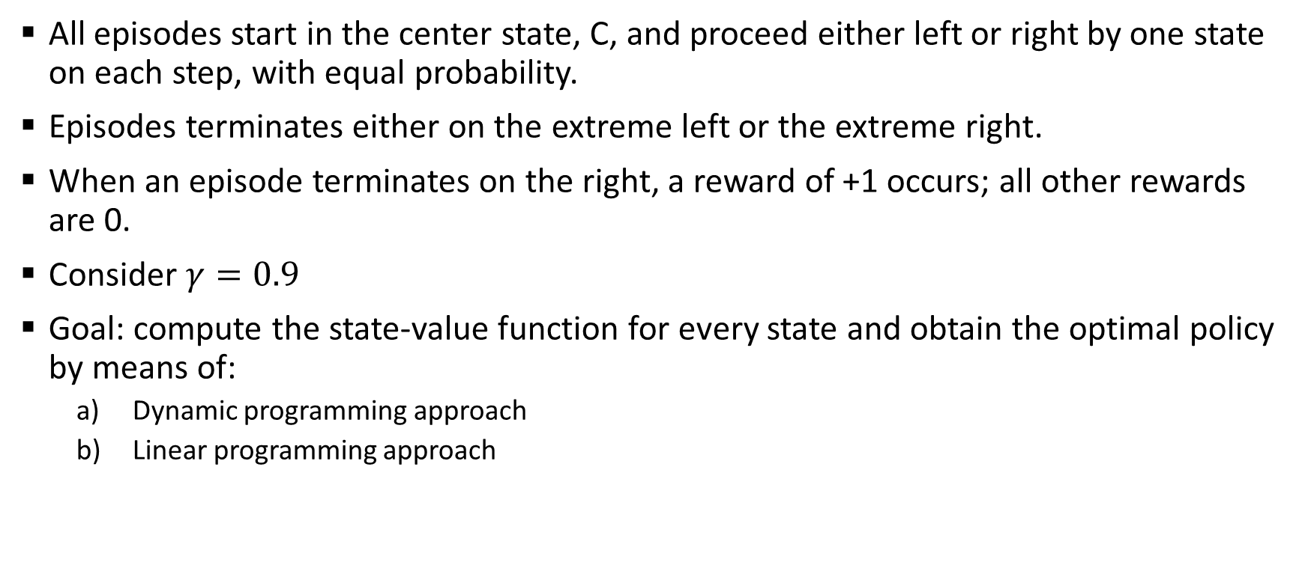
Example: random walk problem
All episodes start in the center state, C, and proceed either left or right by one state on each step, with equal probability.
Episodes terminates either on the extreme left or the extreme right.
When an episode terminates on the right, a reward of +1 occurs; all other rewards are 0.
Consider $γ=0.9$
Goal: compute the state-value function for every state and obtain the optimal policy by means of:
Dynamic programming approach
Linear programming approach
T1
T2

Slide 9
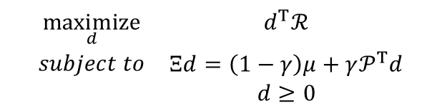
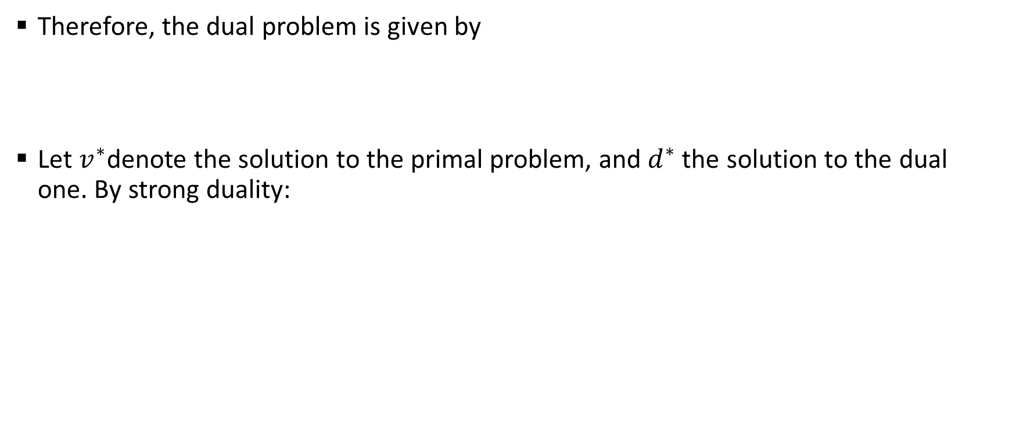
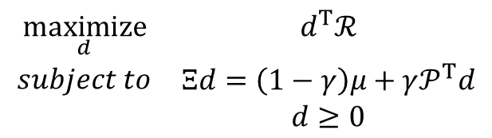
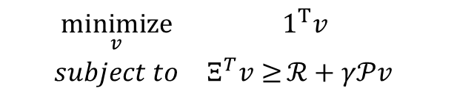
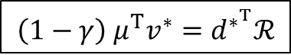
Dual representation of the LP approach
Therefore, the dual problem is given by
Let $v^{∗}$denote the solution to the primal problem, and $d^{∗}$ the solution to the dual one. By strong duality:
$$\begin{matrix}\underset{d}{maximize} & d^{T}ℛ \\ \begin{aligned}subject to \\ \end{aligned} & \begin{matrix}Ξd=\left(1−γ\right)μ+γ𝒫^{T}d \\ d≥0\end{matrix}\end{matrix}$$
$$\begin{matrix}\underset{v}{minimize} & 1^{T}v \\ subject to & Ξ^{T}v≥{ℛ+γ𝒫v} \end{matrix}$$
$$\begin{matrix}\underset{d}{maximize} & d^{T}ℛ \\ \begin{aligned}subject to \\ \end{aligned} & \begin{matrix}Ξd=\left(1−γ\right)μ+γ𝒫^{T}d \\ d≥0\end{matrix}\end{matrix}$$
PRIMAL PROBLEM
DUAL PROBLEM
$$\left(1−γ\right) μ^{T}v^{∗}=d^{∗^{T}}ℛ$$
STRONG DUALITY

Slide 10
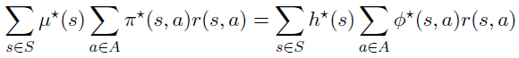
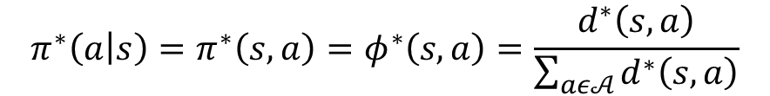
Why using dual representation?
Using the strong duality condition and unrolling both sides, we get
We conclude that we can obtain the optimal policy from the optimal dual variable
$$π^{∗}\left(a | s\right)=π^{∗}\left(s,a\right)=φ^{∗}\left(s,a\right)=\frac{d^{∗}\left(s,a\right)}{\sum_{aε𝒜}{d^{∗}\left(s,a\right)}}$$
While the primal linear problem searches the optimal value, the dual formulation searches in the policy space

Slide 11
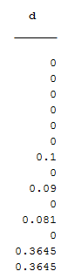
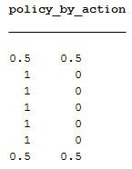
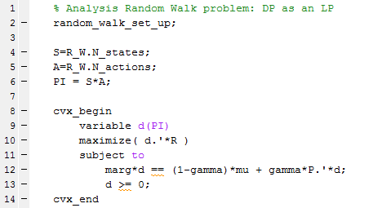
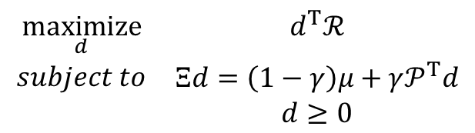

Example: random walk problem (cont.)
Solving the dual problem we obtain the same results as the primal and value iteration
$$\begin{matrix}\underset{d}{maximize} & d^{T}ℛ \\ \begin{aligned}subject to \\ \end{aligned} & \begin{matrix}Ξd=\left(1−γ\right)μ+γ𝒫^{T}d \\ d≥0\end{matrix}\end{matrix}$$
DUAL PROBLEM
$$π^{∗}\left(a | s\right)=\frac{d^{∗}\left(s,a\right)}{\sum_{aε𝒜}{d^{∗}\left(s,a\right)}}$$
a1 = right
a2 = left

Slide 12
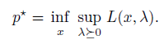
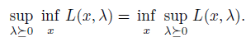
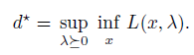
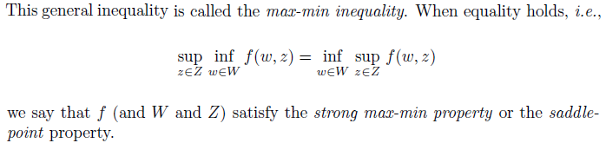
Dual methods for solving the DP: saddle point (I)
By strong duality, we can express:
The order of the minimization over x and the maximization over λ>0 can be switched without affecting the result

Slide 13
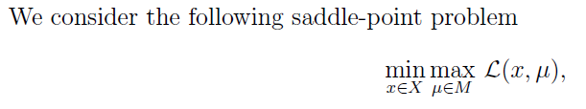
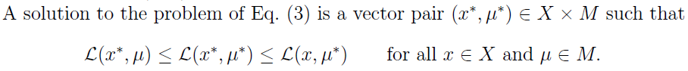
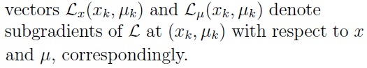
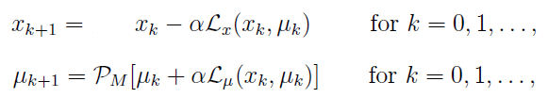
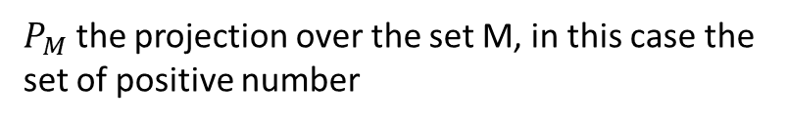
Dual methods for solving the DP: saddle point (II)
Possibility of doing an stochastic gradient → Arrow-Hurwicz algorithm
To generate approximate solutions to problem (3), we consider a subgradient method motivated by Arrow-Hurwicz algorithm. The method has the following form:
$P_{M}$ the projection over the set M, in this case the set of positive number

Slide 14
Dual methods for solving the DP: saddle point (III)
Both solutions (Lagrangian of primal and dual problem) highly oscillating. Never convergence was reached.
Tried the equivalent problem with CVX when v/d fixed and neither convergence was reached.
New suggestion: DUAL ASCENT

Slide 15
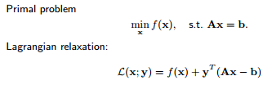
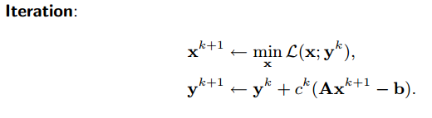
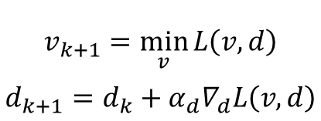
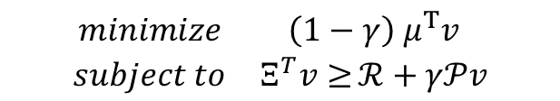
Dual methods for solving the DP: dual ascent (I)
$$\begin{matrix}minimize & \left(1−γ\right) μ^{T}v \\ subject to & Ξ^{T}v≥{ℛ+γ𝒫v}\end{matrix}$$
$$L\left(v,d\right)=\left(1−γ\right) μ^{T}v+d^{T}(ℛ+γ𝒫v−Ξ^{T}v)$$
$$v_{k+1}=\min_{v}{L\left(v,d\right)}$$
$$d_{k+1}=d_{k}+α_{d}∇_{d}L\left(v,d\right)$$
[http://www.math.ucla.edu/~wotaoyin/summer2013/slides/Lec07_Dual_Methods_part_1.pdf]

Slide 16





Dual methods for solving the DP: dual ascent (II)
$$v_{k+1}=\min_{v}{L\left(v,d\right)}$$
$$d_{k+1}=d_{k}+α_{d}∇_{d}L\left(v,d\right)$$
Both minimization methods showed convergence
Better using temporal difference (TD) → suitable for sthocastic gradient descent
Model-based method
¡Policy $Π$ extracted from d!
$$v_{k+1}={\left(I−γΠP\right)}^{−1}ΠR$$
$$∇_{d}L\left(v,d\right)=ℛ+γ𝒫v−Ξ^{T}v$$
$$\min_{v}{L\left(v,d\right)}=$$
Model-free method (TD)

Slide 17


Dual methods for solving the DP: dual ascent (III)
For exp = 1:numExperiments
Random initialization of d and v
For rep = 1:numRepetitions
For epi = 1:numEpisodes
set initial state
while notTerminal
select action (ε-d)
execute action, get next state and reward
$v_{k+1}(s)=v_{k}(s)+α_{td}[ℛ\left(s,a,s^{′}\right)+γv\left(s^{′}\right)−v\left(s\right)]$
collect episode transitions (s, a, s’, r)
end
end
For the same numEpisodes and same collected transitions
$d_{k+1}\left(s,a\right)=\max{{(d}_{k}\left(s,a\right)+α_{d}\left[ℛ\left(s,a,s^{′}\right)+γ\sum_{s^{′}}{𝒫\left(s^{′}|s,a\right)v\left(s^{′}\right)}−v\left(s\right)\right]},0)$
end
end
end
numExperiments independent experiments…
….of numRepetitions repetitions of a set of…
….numEpisodes episodes.
Each set of numEpisodes episodes iterates, first over v, to assure convergence of v, and then over d, to assure convergence of d.
Each numEpisodes episode is a policy improvement.
Each numRepetitions repetitons is composed by policy evaluation (v loop) and policy improvement (d loop)
$$a=\left\{\begin{aligned}\begin{matrix}rand(A) & with p=ε\end{matrix} \\ \begin{matrix}d(s,A) & with p=1−ε\end{matrix}\end{aligned}\right.$$
select action (ε-d)
Notes:
El búcle de la v sería policy evaluation y el de la d policy improvement

Slide 18
Content
LAST PRESENTATION REVIEW
Theoretical basis
TESTING THE DUAL-ASCENT ALGORITHM: RANDOM WALK PROBLEM (MODIFIED)
Roadmap: where are we going?
Dual-ascent with linear function approximation
Algorithm foundations
Random walk
Mountain car
Future lines (04/05/2017)

Slide 19

Example: random walk problem (dual ascent)
Modified version
Nstates/2 states with random reward between 1 and 2. Last state on the right more reward, 150, to assure convergence.
Nstates parametrizable (Nstates = 13 was chosen for testing)
Random transition matrix (i.e: when action is “left”, you go left with $p_{left}=0.8−1$ probability and right with$p_{right}=1−p_{left}$ probability)
T1
T2

Slide 20
Calibration
Dual ascent algorithm composed by 2 steps:
Policy evaluation (minimization of v – TD approach)
Policy improvement (maximization of d – dual variable representing the policy)
Necessary a calibration process
Assure TD/policy evaluation convergence
Assure policy convergence in dual-ascent algorithm for exact method (model-based).
Assure policy convergence in dual-ascent algorithm for TD method (model-free, stochastic gradient)

Slide 21
Comparison
Comparison between dual ascent (DA) exact (model-based), DA TD (model-free), SARSA and Q-learning. All of them with optimal parameters.

Slide 22
Content
Last presentation review
Theoretical basis
Testing the dual-ascent algorithm: random walk problem (modified)
ROADMAP: WHERE ARE WE GOING?
Dual-ascent with linear function approximation
Algorithm foundations
Random walk
Mountain car
Future lines (04/05/2017)

Slide 23
Roadmap: where are we going?
Algorithm… | Compare with… | Problems to test with…
Dual-Ascent (DA): Model based → exact solution (DP) Model free → stochastic gradient (RL) | SARSA Q-learning Double Q-learning | Random walk (classical) Random walk (modified) Cliff
DA with Linear Function Approximation (DA-LFA) | LSPI LSTD GTD2 Variance reduction | Chain walk (RL course version) Mountain car
DA with Non-Linear Function Approximation (DA-NLFA) | Deep Q-learning (DQN) Neural fitted Q-iteration (NFQ) | Mountain Car Cart-Pole Videogames
¡¡CONTINUOUS STATE SPACE!!
Neural networks
Python
OpenAI

Slide 24
Content
Last presentation review
Theoretical basis
Testing the dual-ascent algorithm: random walk problem (modified)
Roadmap: where are we going?
DUAL-ASCENT WITH LINEAR FUNCTION APPROXIMATION
Algorithm foundations
Random walk
Mountain car
Future lines (04/05/2017)

Slide 25









Dual-Ascent with Linear Function Approximation (DA-LFA) (I)
$$𝒫^{π}=Π𝒫$$
$$ℛ^{π}=Πℛ$$
a
$$v^{π}=ℛ^{π}+γ𝒫^{π}v^{π}$$
$$q^{π}=ℛ+γ𝒫Πq^{π}$$
Linear function approximation
Projected Bellman equations
Exact solution (model based)
Stochastic solution (model free)
$\hat{θ^{∗}}=({\hat{φ}}^{T}\hat{φ}−γ{\hat{φ}}^{T}{\hat{φ}}^{′})$ ${\hat{φ}}^{T}\hat{R}$
Notes:
Las nuevas ecuaciones de punto fijo con la aproximación de funciones podrían no tener solución porque el lado derecho no cae en el range space de la matriz de basis functions/features. Por ello, será necesario proyectar dicho lado derecho en el range space de la matriz de features.
D: matriz diagonal con la limiting stationary state visitation distribution asociada a los estados de la cadena de markov

Slide 26




DA-LFA (II)
For exp = 1:numExperiments
Random initialization of d and v. Generate $φ$ matrix
For rep = 1:numRepetitions
For epi = 1:numEpisodes
set initial state
while notTerminal
select action (ε-d)
execute action, get next state and reward
$v_{k+1}(s)=v_{k}(s)+α_{td}[ℛ\left(s,a,s^{′}\right)+γv\left(s^{′}\right)−v\left(s\right)]$
collect episode transitions (s, a, s’, r)
end
end
For the same numEpisodes and same collected transitions
$d_{k+1}\left(s,a\right)=\max{(0,d_{k}\left(s,a\right)+α_{d}\left[r+γv\left(s′\right)−v\left(s\right)\right])}$
end
end
end
$φ_{t}$(ind,:) = GetStateFeatures($s_{t}$);
$φ_{t+1}$(ind,:) = GetStateFeatures($s_{t+1}$);
$R$(ind,:) = r;
$\hat{θ^{∗}}=({\hat{φ_{t}}}^{T} \hat{φ_{t}}−γ{{\hat{φ}}_{t}}^{T} \hat{φ_{t+1}})$ ${\hat{φ_{t}}}^{T}\hat{R}$
$$v=φ\hat{θ^{∗}}$$
Notes:
E

Slide 27

Example: chain walk (RL course version) (I)

Slide 28
Example: chain walk (RL course version) (II)

Slide 29




Example: mountain car (I)
An issue appears when working with continuous state space problems…
For epi = 1:numEpisodes
set initial state
while notTerminal
select action (ε-d)
execute action, get next state and reward
$v_{k+1}(s)=v_{k}(s)+α_{td}[ℛ\left(s,a,s^{′}\right)+γv\left(s^{′}\right)−v\left(s\right)]$
collect episode transitions (s, a, s’, r)
end
end
For the same numEpisodes and same collected transitions
$d_{k+1}\left(s,a\right)=\max{(0,d_{k}\left(s,a\right)+α_{d}\left[r+γv\left(s′\right)−v\left(s\right)\right])}$
end
$φ_{t}$(ind,:) = GetStateFeatures($s_{t}$);
$φ_{t+1}$(ind,:) = GetStateFeatures($s_{t+1}$);
$R$(ind,:) = r;
$\hat{θ^{∗}}=({\hat{φ_{t}}}^{T} \hat{φ_{t}}−γ{{\hat{φ}}_{t}}^{T} \hat{φ_{t+1}})$ ${\hat{φ_{t}}}^{T}\hat{R}$
$$v=φ\hat{θ^{∗}}$$
?

Slide 30
Content
Last presentation review
Theoretical basis
Testing the dual-ascent algorithm: random walk problem (modified)
Roadmap: where are we going?
Dual-ascent with linear function approximation
Algorithm foundations
Random walk
Mountain car
FUTURE LINES (04/05/2017)

Slide 31
Future lines (04/05/2017)
The milestones for next meeting are…
Reinforcement Learning in Large and continuous spaces. Policy approximation
Motivation
Families of basis functions
Projected Bellman Equation

